Slide 1
Defend the net
Introduction
This slide deck contains a class set of alert and defense cards for the ‘Defend the net’ game.
Print a copy of the following slides in this resource and cut the cards in preparation for the game.
You will need one pile of alert cards and one pile of defense cards. Some of the defense cards have been repeated to increase the odds of learners receiving these cards in the game.
Note: You might want to print them onto different coloured paper to make them more distinguishable.
Image sources:
Hacker - https://pixabay.com/vectors/hacker-anonymous-criminal-internet-6639626/
Virus - https://pixabay.com/vectors/coronavirus-line-art-virus-5019475/
Memory stick - https://pixabay.com/vectors/usb-disk-disc-storage-technology-47552/
Door - https://pixabay.com/vectors/the-door-open-door-openly-office-1389755/
Stranger - https://pixabay.com/vectors/man-walking-confident-silhouette-2759950/
Lock - https://pixabay.com/vectors/padlock-lock-security-protection-303266/
Fish hook - https://pixabay.com/vectors/hook-fishing-angling-fishhook-1747990/
Man in glasses - https://pixabay.com/vectors/boy-eye-glasses-hair-hipster-icon-1299608/
Tractor - https://pixabay.com/vectors/tractor-equipment-machinery-work-39882/
Safe - https://pixabay.com/vectors/safety-locker-safe-money-locked-158528/
Key - https://pixabay.com/vectors/key-lock-web-1294351/
Calendar - https://pixabay.com/vectors/calendar-date-schedule-icon-1294841/

Slide 2
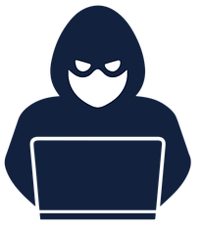





Alert cards
Alert!
Alert!
Alert!
Alert!
3
2
1
1
moves
moves
move
move
The DDoS attack
There is an unusual increase in traffic to the web server. This is causing the site to be unavailable.
Potential defense techniques
Firewall
Increase bandwidth
Virus
A virus known as Worm589 is spreading through the internet. You are concerned that your network might be next!
Potential defense techniques
Anti-malware software
Antivirus software
Update software
The memory stick
Your staff need to take work home on memory sticks. You need to make sure the data can’t be stolen!
Potential defense techniques
Encryption software
Data protection training
Access rights
A staff member has discovered that they can see financial details of their colleagues.
Potential defense techniques
Configure user access rights for all staff
Alert!
Alert!
Alert!
Alert!
1
3
2
2
move
moves
moves
moves
Access rights
You discover that the staff using your network have been installing software without your permission.
Potential defense techniques
Configure access rights
Stranger danger
You are concerned that a hacker might enter the office and attempt to access the network. Staff need to know who is meant to be in the building.
Potential defense techniques
Use staff ID cards
Virus
You want to set up long-term protection from viruses on your network.
Potential defense techniques
Anti-malware software
Antivirus software
Update software
Firewall
The password
You walk past a staff member’s desk and notice that their passwords are all on a post-it note stuck to their monitor.
Potential defense techniques
Use a password manager

Slide 3



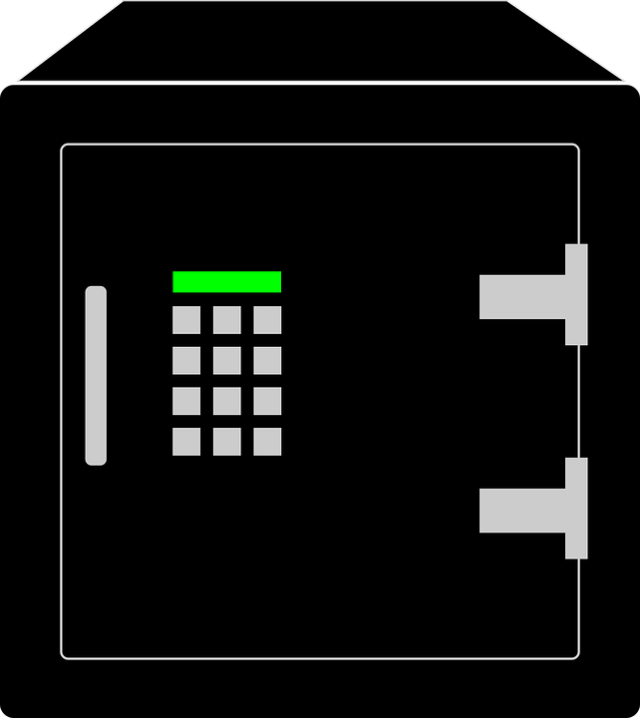
Alert cards
Alert!
Alert!
Alert!
Alert!
2
1
3
2
moves
move
moves
moves
Phishing
Every staff member in the company has received an email from an unknown payroll company asking for their bank details so that they can get paid.
Potential defense techniques
Staff training
Spam filter
Phishing
You receive an email asking you to sign up to the company’s new office communication system. You must enter your company email address and password.
Potential defense techniques
Staff training
Spam filter
Shouldering
Some staff members’ monitors can be seen from the busy high street outside. You are concerned that people might see passwords or sensitive data.
Potential defense techniques
Position desks away from windows
Shouldering
Staff access the building using a four digit number. You are concerned that people could watch the code being entered and access the building.
Potential defense techniques
Use staff ID cards
Alert!
Alert!
Alert!
Alert!
1
3
2
3
move
moves
moves
moves
Blagging
The finance team receives an email from an employee on a work trip asking for money to fly home. They want the money to be sent to an unknown bank account.
Potential defense techniques
Staff training
Blagging
A call is made to the company from a security service stating that their financial details have been stolen. They ask for a list of staff payroll numbers and addresses to verify stolen data.
Potential defense techniques
Penetration testing
Pharming
A staff member visits the company website and notices that the URL has changed. The logo is also a different colour.
Potential defense techniques
Staff training
Anti-malware software
Back it up
The office next door had a fire last night. They have lost all of their client data. You need a strategy for preventing this happening with your data.
Potential defense techniques
Off-site backups

Slide 4


Alert cards
Alert!
Alert!
Alert!
Alert!
2
3
2
2
moves
moves
moves
moves
Device theft
Some staff visit other offices regularly and take their laptops that contain sensitive data. You must have a method for protecting the data.
Potential defense techniques
Password managers
Anti-theft software
A free memory stick
A staff member receives a free memory stick in the post. They plug it into their work laptop. It contains malware that could be used to steal data.
Potential defense techniques
Check for malware on all external peripherals
Out of date
You hear of a new virus that attacks vulnerabilities in out-of-date software. You want to make sure that your network is protected.
Potential defense techniques
Update software
Brute force
You discover a suspicious device attached to the reception desk computer. You realise that it is attempting a brute force attack and trying millions of different passwords to gain entry.
Potential defense techniques
Lock after 3 attempts

Slide 5

Defense cards
Firewall
Bandwidth
Anti-malware
Antivirus
A firewall can be implemented in hardware, software, or a combination of both.
The firewall sits between two networks, usually a 'trusted' network (such as your home LAN) and an 'untrusted' network (such as the internet), and prevents malicious traffic by filtering data packets travelling between the two networks.
Increasing bandwidth during a DDoS attack could potentially ease the load on the network and enable legitimate users to access the website.
This isn’t always successful and depends on the scale of the DDoS attack.
Anti-malware software is used to detect and remove malware such as viruses, trojans, and spyware from computers.
Anti-malware software can have a real-time checker that scans files before they are used to keep the computer safe, and also have scheduled scans to perform checks upon the computer files on a regular basis.
Antivirus software is used to detect and remove viruses from computers.
Virus checks are run periodically on all files. New files are also checked before they are used.
Antivirus and anti-malware software are sometimes seen to be the same thing. However, anti-malware can offer more protection
Updates
Encryption
Data protection
User access
Software updates are essential for maintaining security. Hackers are always looking for vulnerabilities in software that they can exploit. When a vulnerability is found, software companies must fix them and release an update to customers.
It is important that customers regularly update their software.
Encryption software is used to keep data and communications secret from interceptors.
If data falls into the wrong hands, then encryption makes it much more difficult for people to view the encrypted data.
Any sensitive data should be encrypted before it is distributed.
Any company that deals with the personal data of others has a responsibility to protect that data.
By providing data protection training, staff can be better informed of their role and responsibilities surrounding the protection of data.
Network policies often control who can access the network, which files or services the users can or cannot access, and what type of access rights they have, for example the right to view, edit, or delete a file. Setting these permissions helps to prevent unauthorised access to sensitive information or management of network services.

Slide 6
Defense cards
ID cards
Password Manager
Training
Spam filter
Identification (ID) cards allow staff members in an organisation to see who has permission to be in the building. This is an important aspect of security as hackers can often disguise themselves as an employee or contractor to gain access to the network.
ID cards can also be used to gain entry to restricted areas.
Regular staff training on how to keep the network secure is useful in keeping staff up to date with the latest security issues.
It can also remind them of things, such as phishing, blagging, and shouldering to keep them alert to potential dangers.
Phishing scams are often sent to vast quantities of email accounts in an attempt to trick users into clicking links to malicious websites.
Spam filters can be used to prevent many of these emails reaching the users.
Password managers allow network users to have a secure central location for all of their passwords. This can then be protected by a single, secure password.
Password managers will also create secure passwords for users to avoid them using the same password multiple times.
Position desks
Penetration testing
Off-site backup
Anti-theft
To avoid a shouldering attack, it should not be possible for people outside of the organisation to easily view what a person is typing, or what is on their monitor.
If offices are public facing then desks should be positioned facing away from any windows.
Networks could be damaged by a catastrophic event, such as fire or flood. They could also be intentionally damaged through vandalism.
It is important to backup the data on a network. It is equally important to ensure that there is an off-site backup in case the network servers become damaged.
If a device is stolen then it is important that thieves cannot access the data on that device.
Anti-theft software can be installed onto devices that will delete the data from a device in the event that it is lost or stolen.
Penetration testing is sometimes called ethical hacking. Hackers who work with good intent attempt to break into a network to identify any possible security breaches. If any flaws are found, they are then secured to prevent malicious hackers exploiting them to access the network.

Slide 7
Defense cards
Malware checks
Locked out
Password Manager
Training
Setting a limit for the number of times a user can incorrectly enter a password can stop a brute force attack.
After three attempts, a user should be locked out and have to seek support from the technician or wait a set amount of time before trying again.
Regular staff training on how to keep the network secure is useful in keeping staff up to date with the latest security issues.
It can also remind them of things, such as phishing, blagging, and shouldering to keep them alert to potential dangers.
External peripherals, such as memory sticks, can have malware installed on them.
It is important that any peripheral device that is attached to the network is searched for malware before allowing any files to be opened or transferred to the network.
Password managers allow network users to have a secure central location for all of their passwords. This can then be protected by a single, secure password.
Password managers will also create secure passwords for users to avoid them using the same password multiple times.
Anti-malware
Antivirus
Anti-malware
Antivirus
Anti-malware software is used to detect and remove malware such as viruses, trojans, and spyware from computers.
Anti-malware software can have a real-time checker that scans files before they are used to keep the computer safe, and also have scheduled scans to perform checks upon the computer files on a regular basis.
Antivirus software is used to detect and remove viruses from computers.
Virus checks are run periodically on all files. New files are also checked before they are used.
Antivirus and anti-malware software are sometimes seen to be the same thing. However, anti-malware can offer more protection
Anti-malware software is used to detect and remove malware such as viruses, trojans, and spyware from computers.
Anti-malware software can have a real-time checker that scans files before they are used to keep the computer safe, and also have scheduled scans to perform checks upon the computer files on a regular basis.
Antivirus software is used to detect and remove viruses from computers.
Virus checks are run periodically on all files. New files are also checked before they are used.
Antivirus and anti-malware software are sometimes seen to be the same thing. However, anti-malware can offer more protection

Slide 8
Defense cards
Training
Training
Training
Training
Regular staff training on how to keep the network secure is useful in keeping staff up to date with the latest security issues.
It can also remind them of things, such as phishing, blagging, and shouldering to keep them alert to potential dangers.
Regular staff training on how to keep the network secure is useful in keeping staff up to date with the latest security issues.
It can also remind them of things, such as phishing, blagging, and shouldering to keep them alert to potential dangers.
Regular staff training on how to keep the network secure is useful in keeping staff up to date with the latest security issues.
It can also remind them of things, such as phishing, blagging, and shouldering to keep them alert to potential dangers.
Regular staff training on how to keep the network secure is useful in keeping staff up to date with the latest security issues.
It can also remind them of things, such as phishing, blagging and shouldering to keep them alert to potential dangers.
Penetration testing
Penetration testing is sometimes called ethical hacking. Hackers who work with good intent attempt to break into a network to identify any possible security breaches. If any flaws are found, they are then secured to prevent malicious hackers exploiting them to access the network.

